Slide 1
Research-Agent
CAPSTONE PROJECT
Presented By:
Devyansh Paliwal- IIIT Ranchi & IIT Patna – Computer Science

Slide 2
OUTLINE
Problem Statement (Should not include solution)
Proposed System/Solution
System Development Approach (Technology Used)
Result (Output Image)
Conclusion
Future Scope
References

Slide 3
Problem Statement
A Research Agent is an AI system designed to assist with academic and scientific research tasks. It can autonomously search for literature, summarize papers, and organize references. Using natural language processing, it understands research questions and retrieves relevant information. The agent can generate reports, suggest hypotheses, and even draft sections of research papers. It saves time by automating repetitive tasks like citation management and data extraction. Research Agents enhance efficiency, accuracy, and innovation in both academic and industrial R&D.

Slide 4
Proposed Solution
The proposed system aims to address the challenge of creating an AI Agent which can perform all the scientific and research tasks.
It autonomously search for literature, summarize papers, and organize references using:
Google Search
DuckDuckGo Search
Wikipedia Search
It can also access different websites to gather information.
The proposed solution is designed to always provide tailored responses which are accurate, concise and academically appropriate .

Slide 5
System Approach
System RequiremenThe "System Approach" section outlines the overall strategy and methodology for developing and implementing the rental bike prediction system. Here's a suggested structure for this section:
System requirements:
Windows/Mac
Browser Chrome/Firefox/Edge
Library required to build the model:
IBM Cloud
Watsonx.ai
Watsonx.ai Studio
Watsonx.ai Runtime
IBM Cloud Storage

Slide 6
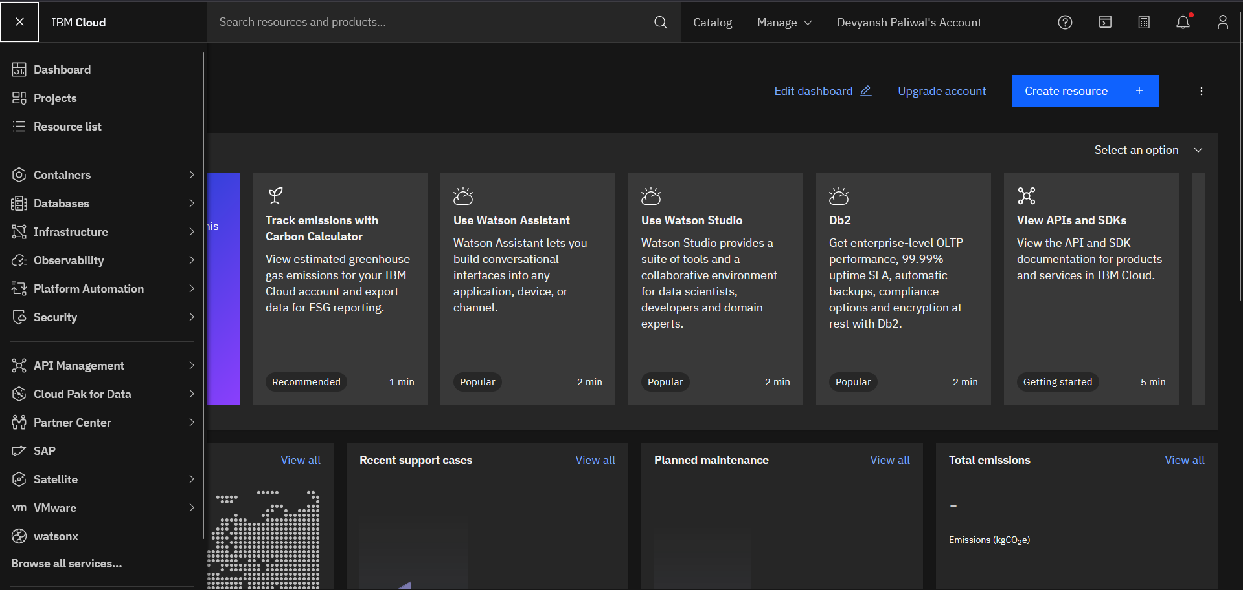
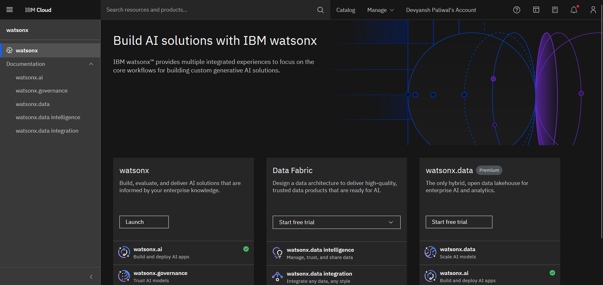
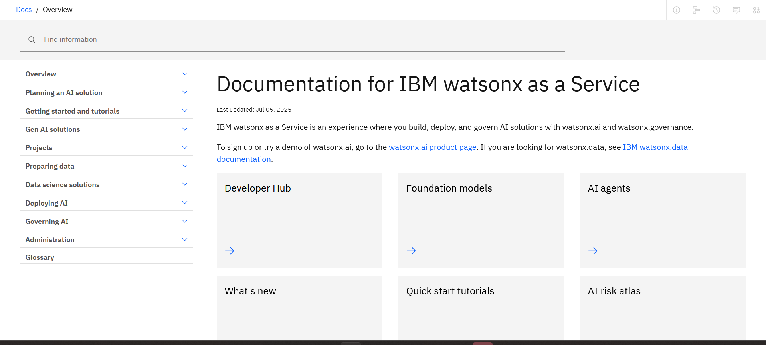
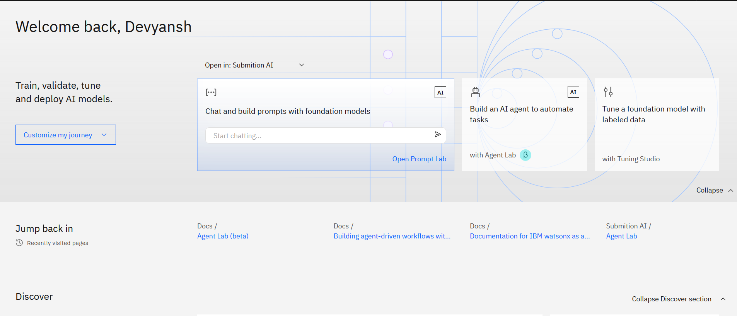
Result
STEP 1
STEP 2
STEP 3
STEP 4

Slide 7
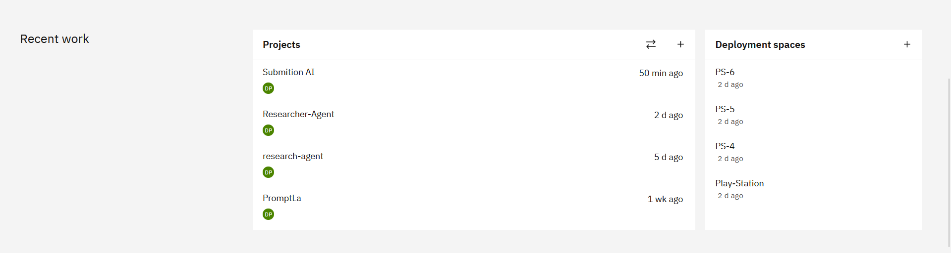
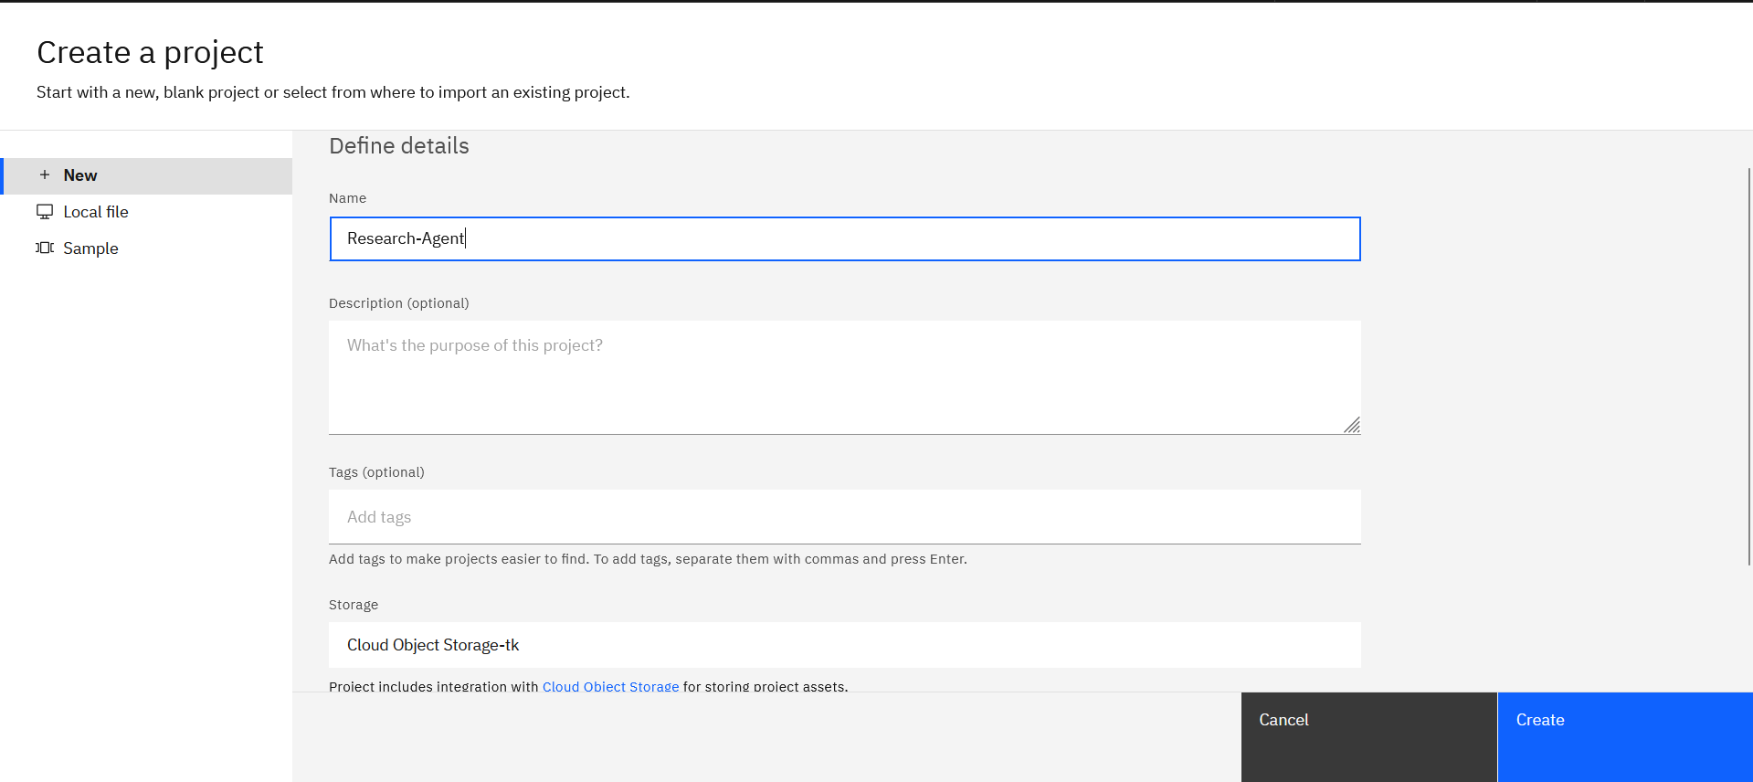
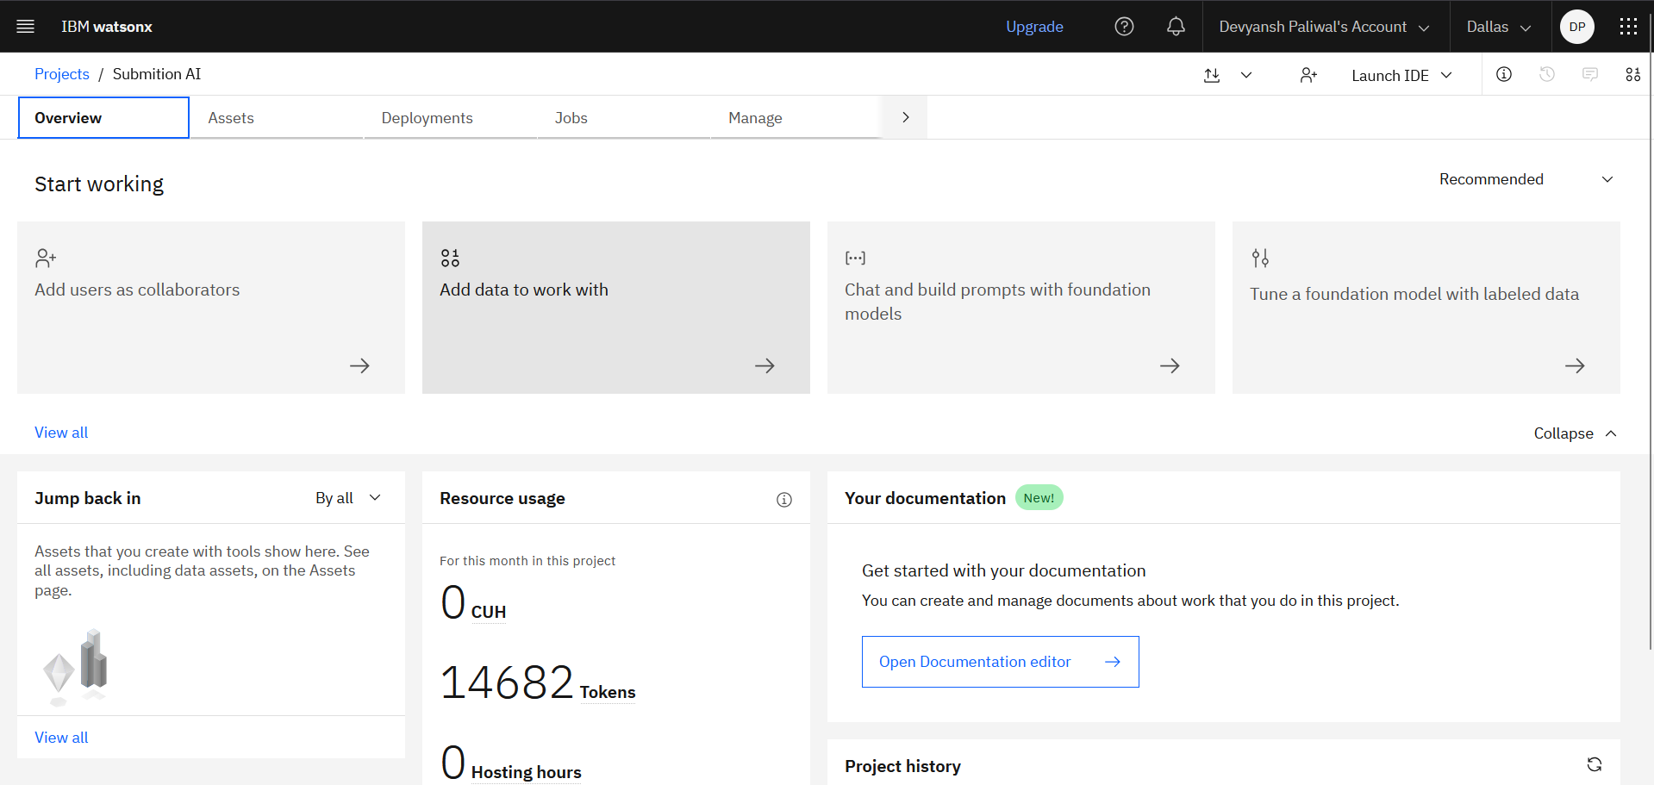
Result
STEP 5
STEP 6
STEP 7
STEP 8

Slide 8
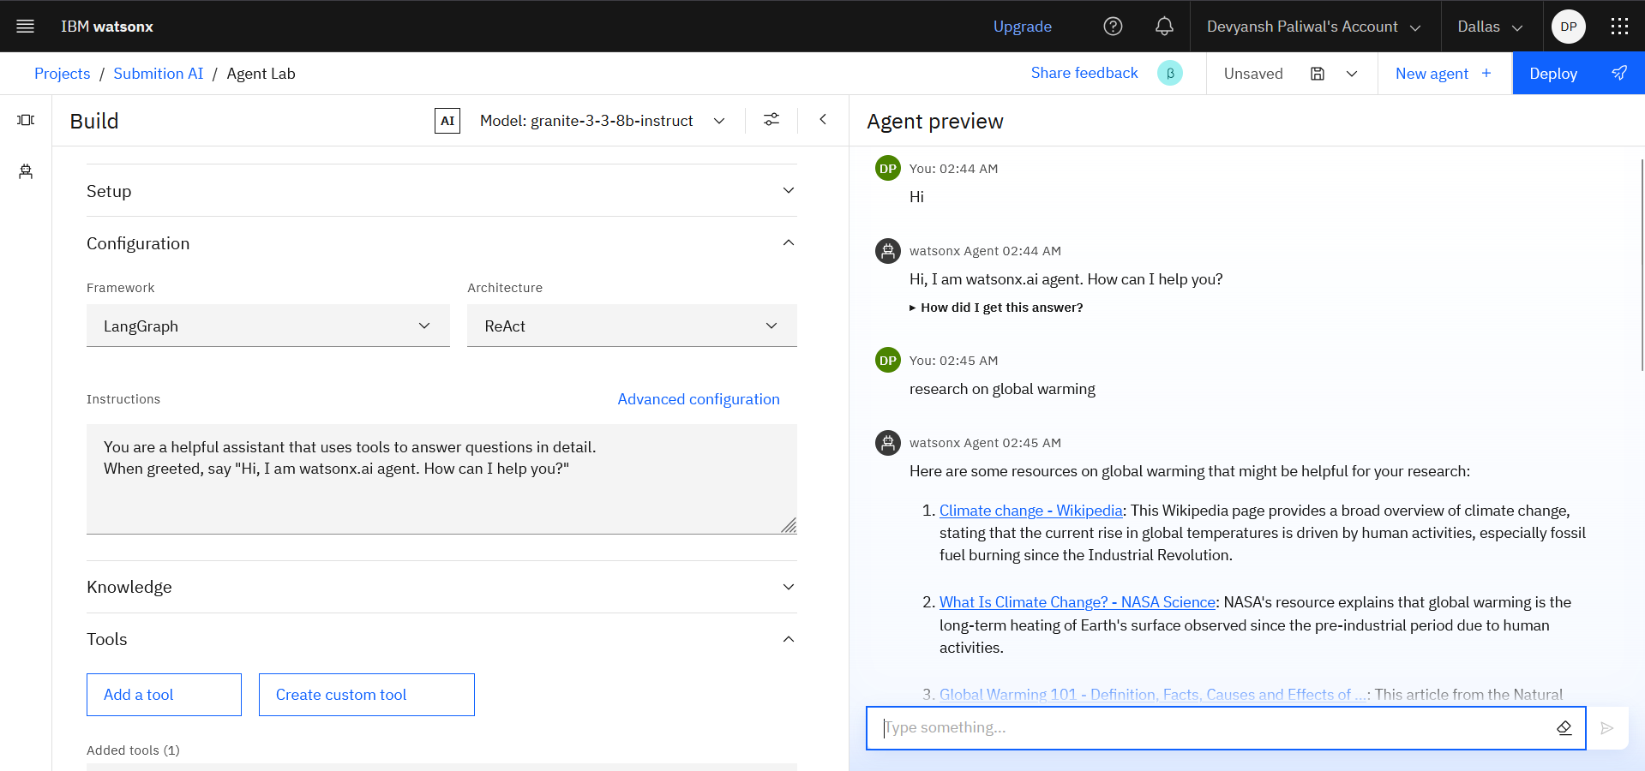
Result
STEP 4

Slide 9
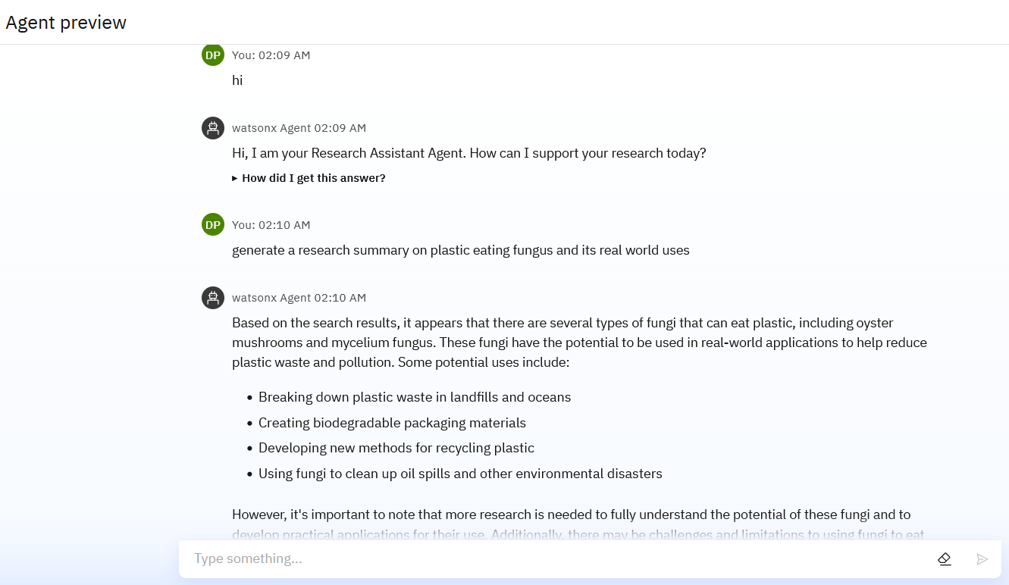
Result

Slide 10
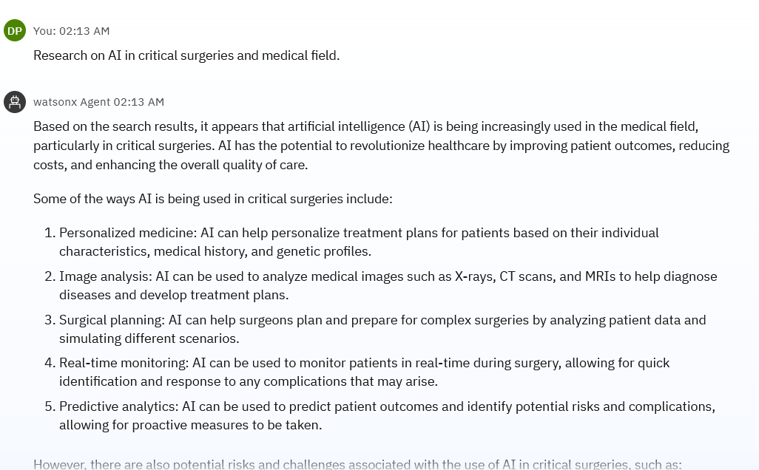
Result

Slide 11
Conclusion
The Research Agent successfully integrates IBM Watsonx.ai's Granite model to generate detailed, AI-driven academic responses based on user prompts. The solution demonstrates effective use of cloud-based LLMs for summarization and content generation, enhancing research productivity.
Potential Improvements:
Add document/PDF upload support
Enable response saving and user authentication
Improve error handling and model response clarity

Slide 12
Future scope
The Research Agent can be significantly enhanced by integrating advanced capabilities such as PDF and document upload support for multi-format summarization, real-time citation extraction using external APIs (e.g., Semantic Scholar), and voice-based query input for accessibility. Future iterations could include personalized user profiles, recommendation of related research articles, and integration with academic databases for verified content. Additionally, deploying the application with user authentication and a dashboard for saved results will make it more interactive. Leveraging IBM Watsonx's continuous improvements, the agent can evolve into a comprehensive AI-powered research assistant for academia and R&D professionals.

Slide 13
References
IBM Cloud
IBM Watsonx.ai
IBM Granite Model

Slide 14
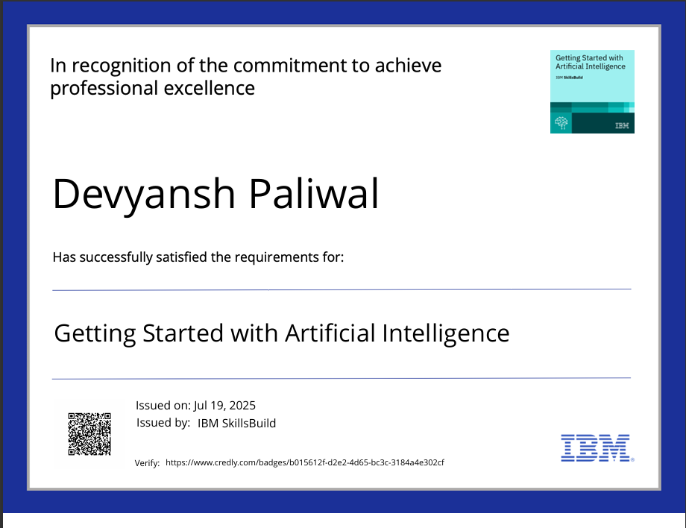
IBM Certifications

Slide 15
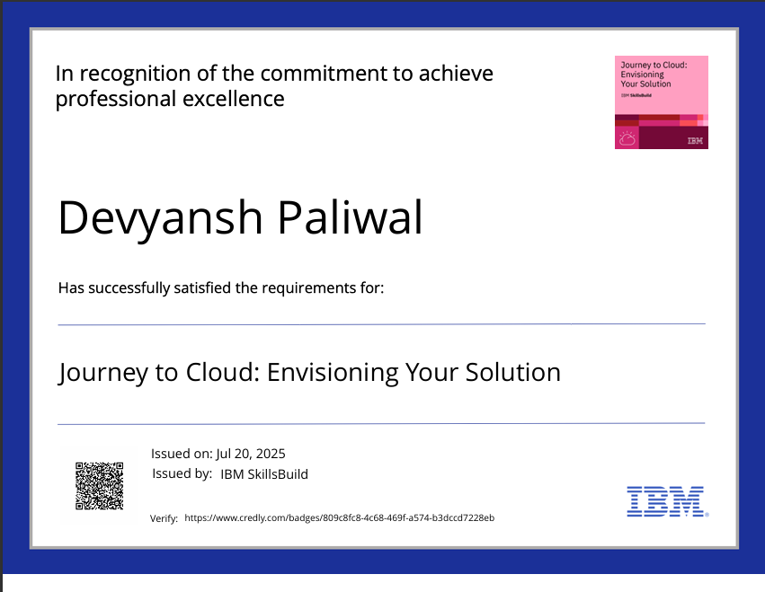
IBM Certifications

Slide 16
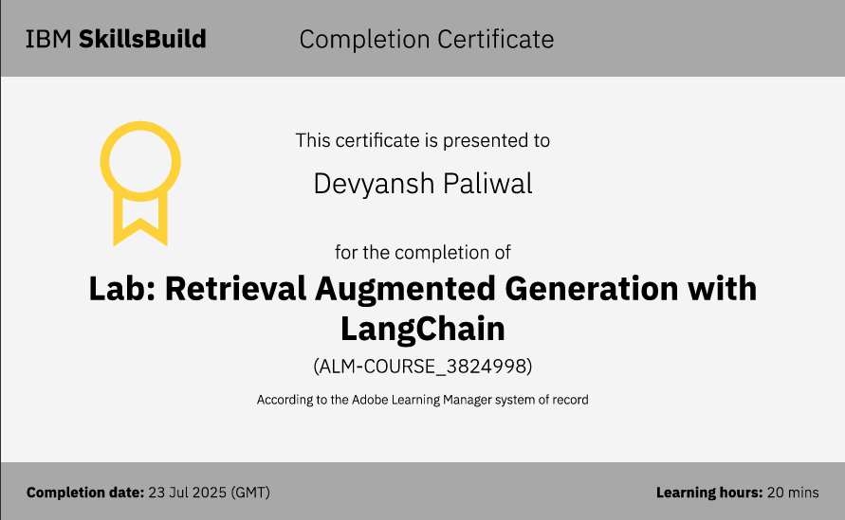
IBM Certifications

Slide 17
THANK YOU

